Slide 1

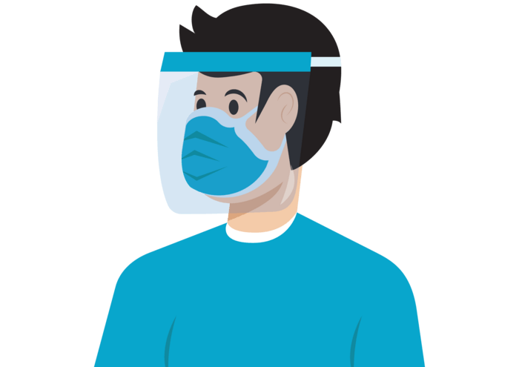


COVID-19 DASHBOARD POWER BI
BY SARTHAK TYAGI

Slide 2
COVID-19 DASHBOARD
Objective: The objective of this project is to develop a dashboard that provides real-time data and analysis of the Covid-19 pandemic. The dashboard aims to provide users with up-to-date information on the spread of the virus, including the number of cases, deaths, recoveries, and active cases.
Methodology: The dashboard has been developed using Power BI. The project uses data from the World Health Organization data repository to populate the dashboard.
Features: The dashboard includes several features that allow users to interact with the data and analyze it in different ways. These features include:
World Map: A world map that shows the number of cases in each country.
Total Cases: KPIs to show the number of cases and deaths.
Mortality Rate: KPI to show the percentage of cases that result in death.
Top 5 Countries: A funnel that shows the top 5 countries with the best vaccination coverage per 100 Population.

Slide 3
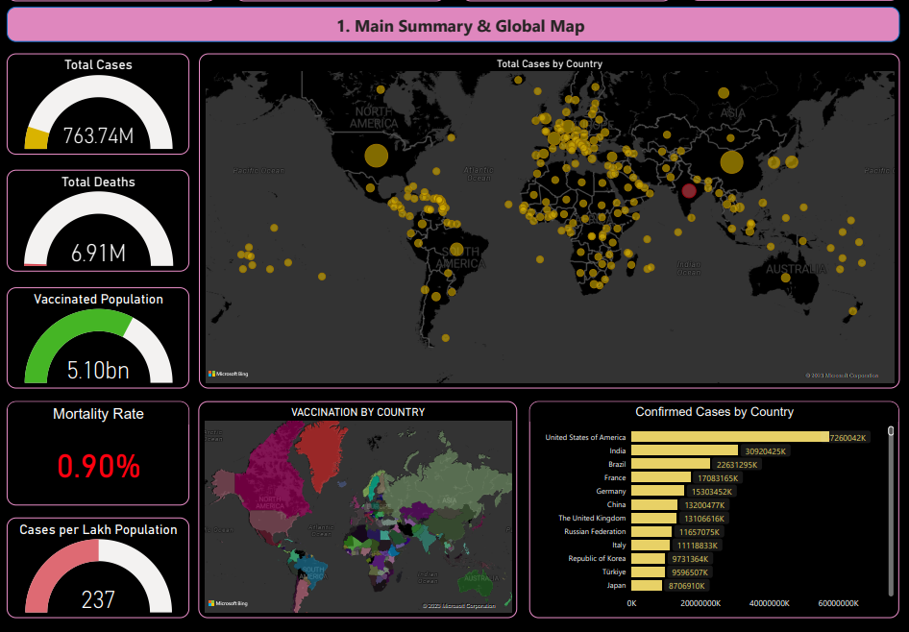
Slide 3
1
I first analyze total cases, total deaths, vaccinated population, mortality rate & cases per lakh population.
I found out USA, India, and Brazil are the top 3 countries in terms of total Cases.

Slide 4
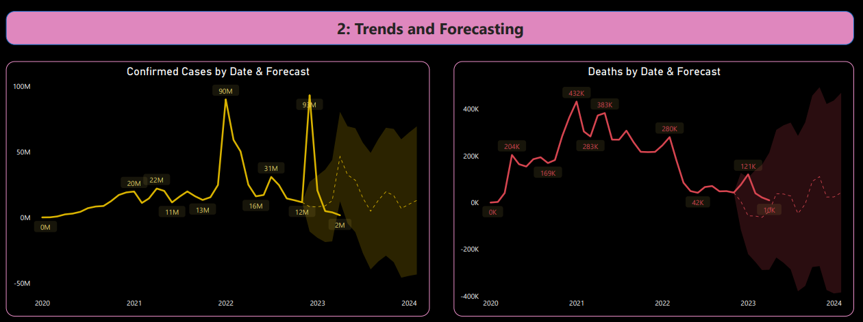
Slide 3
2
In this section, I analyzed the future trend of total cases and deaths. I found out that as cases are decreasing, the number of deaths has also decreased.
We can conclude that Virus is not mutating anymore to severe versions and total cases & death are proportional to each other.

Slide 5
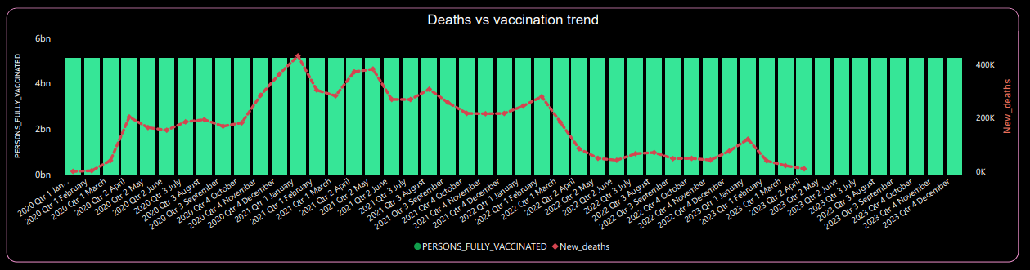
Slide 3
3
In this section, I tried to analyze whether the vaccines are helping us or not and I found out that as the vaccination drive around the world increases the deaths have decreased significantly.
We can further conclude that vaccines are working as expected.

Slide 6
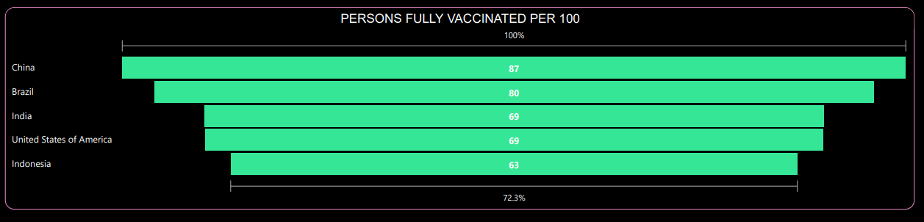
Slide 3
4
In this section, I tried to find countries that are doing great in terms of vaccination.
We can further conclude that China, Brazil, India, the USA, and Indonesia are the top 5 counties in terms of vaccine doses administered per 100 Population.

Slide 7
Conclusion
The Covid-19 Dashboard provides users with a comprehensive view of the pandemic, allowing them to analyze the data in different ways. The dashboard is interactive, user-friendly, and provides real-time data, making it a valuable tool for researchers, policymakers, and the general public.
It is an excellent example of how technology can be used to track and analyze real-time data during a pandemic. The dashboard provides valuable insights into the spread of the virus and can help inform decision-making processes at all levels. The project can be further improved by adding more data sources and expanding the features of the dashboard.
Overall, this project is an effort to use data analytics to monitor and provide insights into the Covid-19 pandemic. The Covid-19 Dashboard provides an easy-to-use, interactive platform for users to access critical information about the pandemic, making it a valuable resource for anyone interested in tracking the spread of the virus.

Slide 8
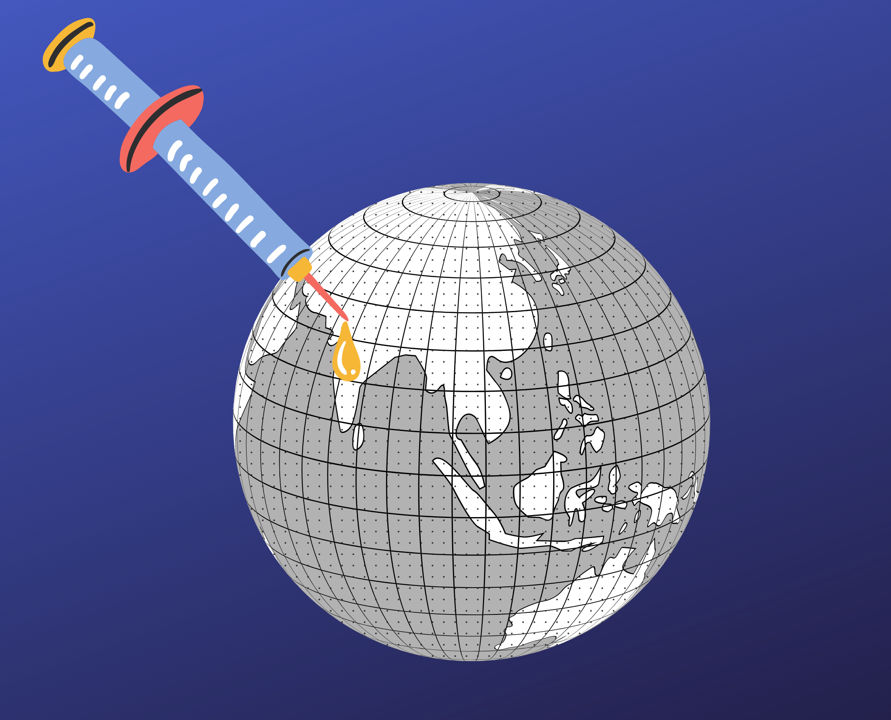
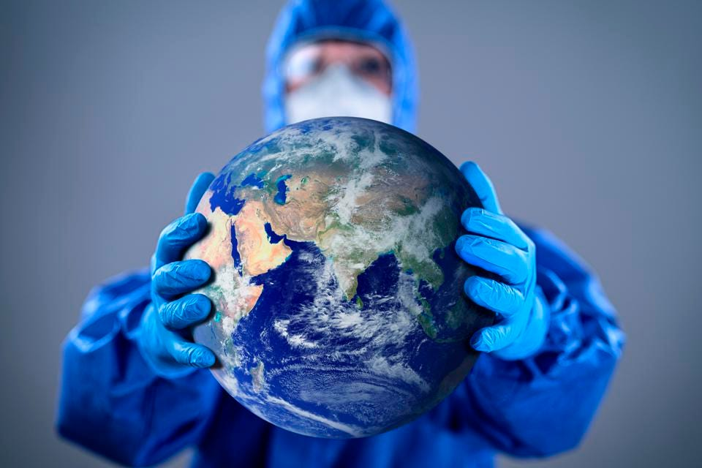
Research Presentation End
BY SARTHAK TYAGI
Notes:
You can use this slide as your opening or closing slide. Should you choose to use it as a closing, make sure you review the main points of your presentation. One creative way to do that is by adding animations to the various graphics on a slide. This slide has 4 different graphics, and, when you view the slideshow, you will see that you can click to reveal the next graphic. Similarly, as you review the main topics in your presentation, you may want each point to show up when you are addressing that topic.
Add animation to images and graphics:
Select your image or graphic.
Click on the Animations tab.
Choose from the options. The animation for this slide is “Split”. The drop-down menu in the Animation section gives even more animations you can use.
If you have multiple graphics or images, you will see a number appear next to it that notes the order of the animations.
Note: You will want to choose the animations carefully. You do not want to make your audience dizzy from your presentation.

